Slide 1
A Magical Journey from Context to Code
Practical
Open Source North 2025!
Notes:
Slides packed with methods, techniques, and approach to building a fully integrated Demo Playground (platform and apps).

Slide 2
Building software that WORKS, through a story you CONNECT with, using solution methods to GUIDE delivery.
A Solution Journey
Notes:
Elevator Pitch → Synopsis

Slide 3
How it Started
From Tutorial to Playground

Slide 4
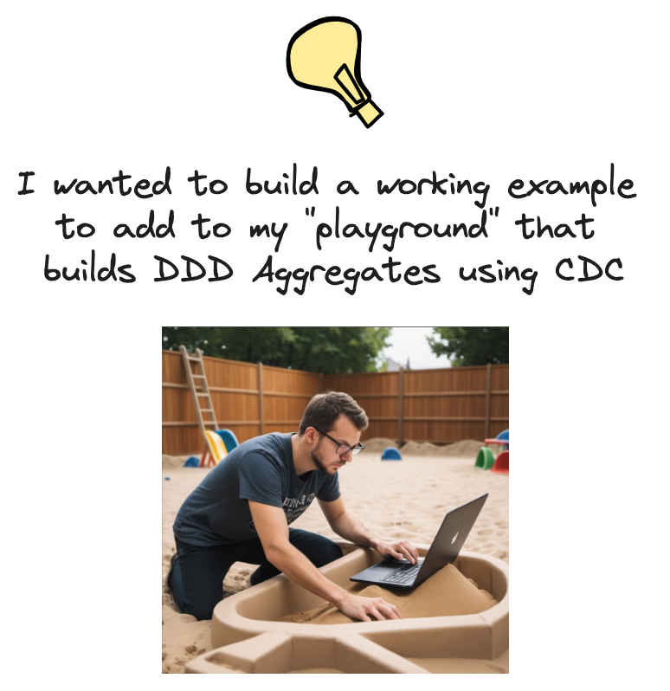
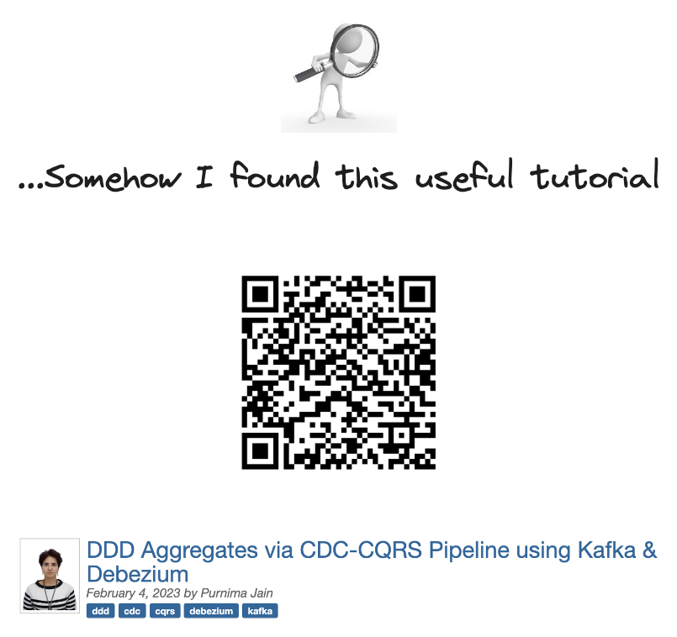
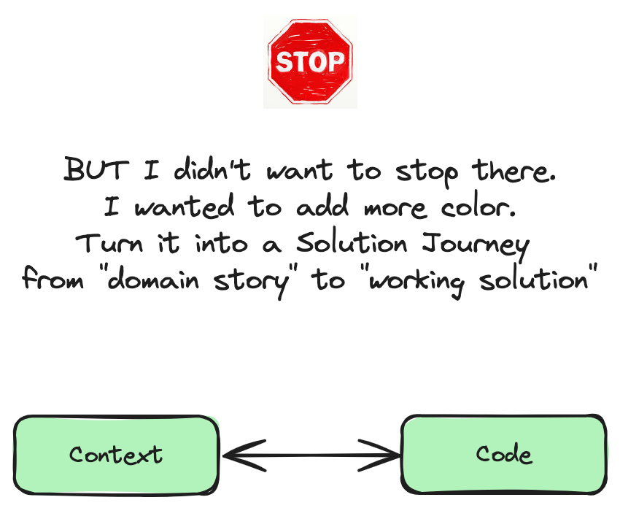

DDD Aggregate --> A cluster of related domain objects (entities and value objects) that are treated as a single unit for consistency
and persistence purposes.
CDC ---------------> Change Data Capture is a technique used to identify and capture data changes (inserts, updates, and deletes) in a database. These changes are made available for downstream processes like building DDD Aggregates
CQRS -------------> Command, Query Responsibility Segregation. Separates read and write operations for
flexibility, performance, scalability, and security.
Kafka -------------> Combines messaging, storage, and stream processing to build real-time data pipelines
Notes:
Adding Color and Context to Code makes it more understandable and BETTER

Slide 5
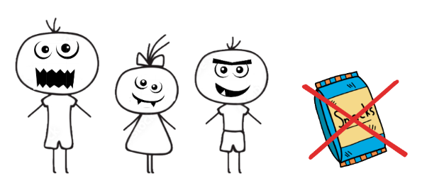
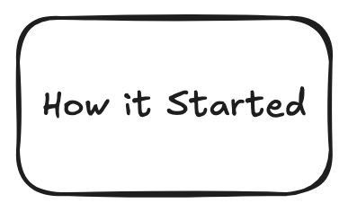
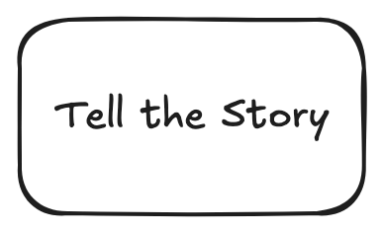
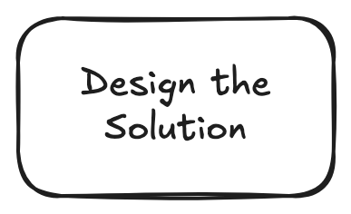
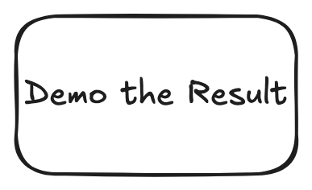
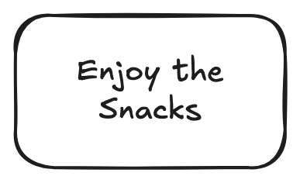




Slide 6
Tell the Story
(Better OUTCOMES when you CONNECT with the Story)

Slide 7
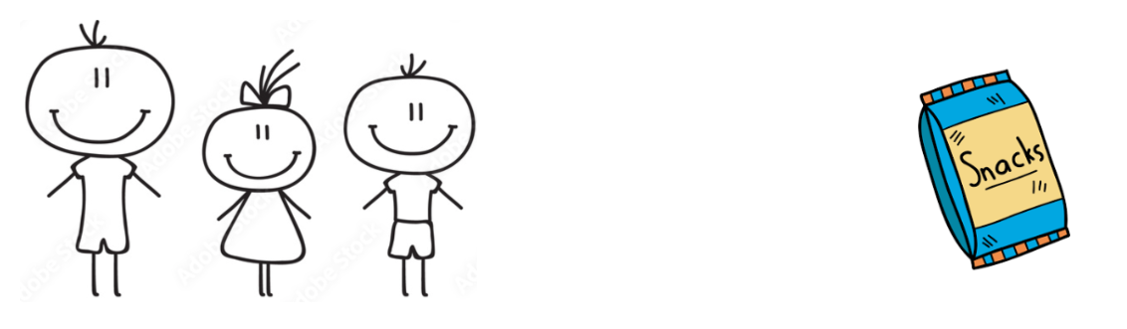
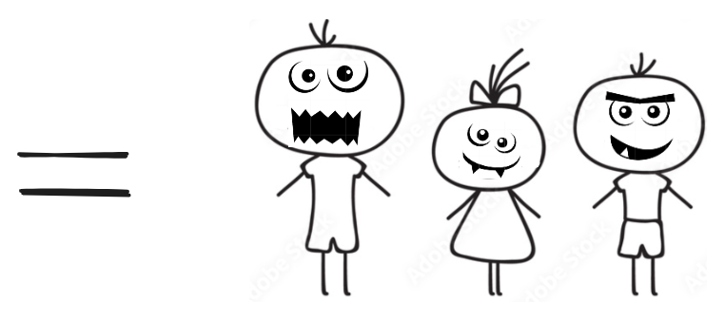

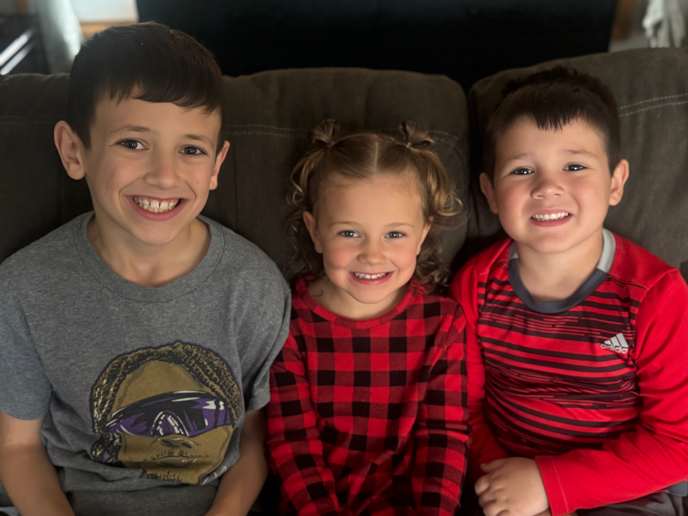
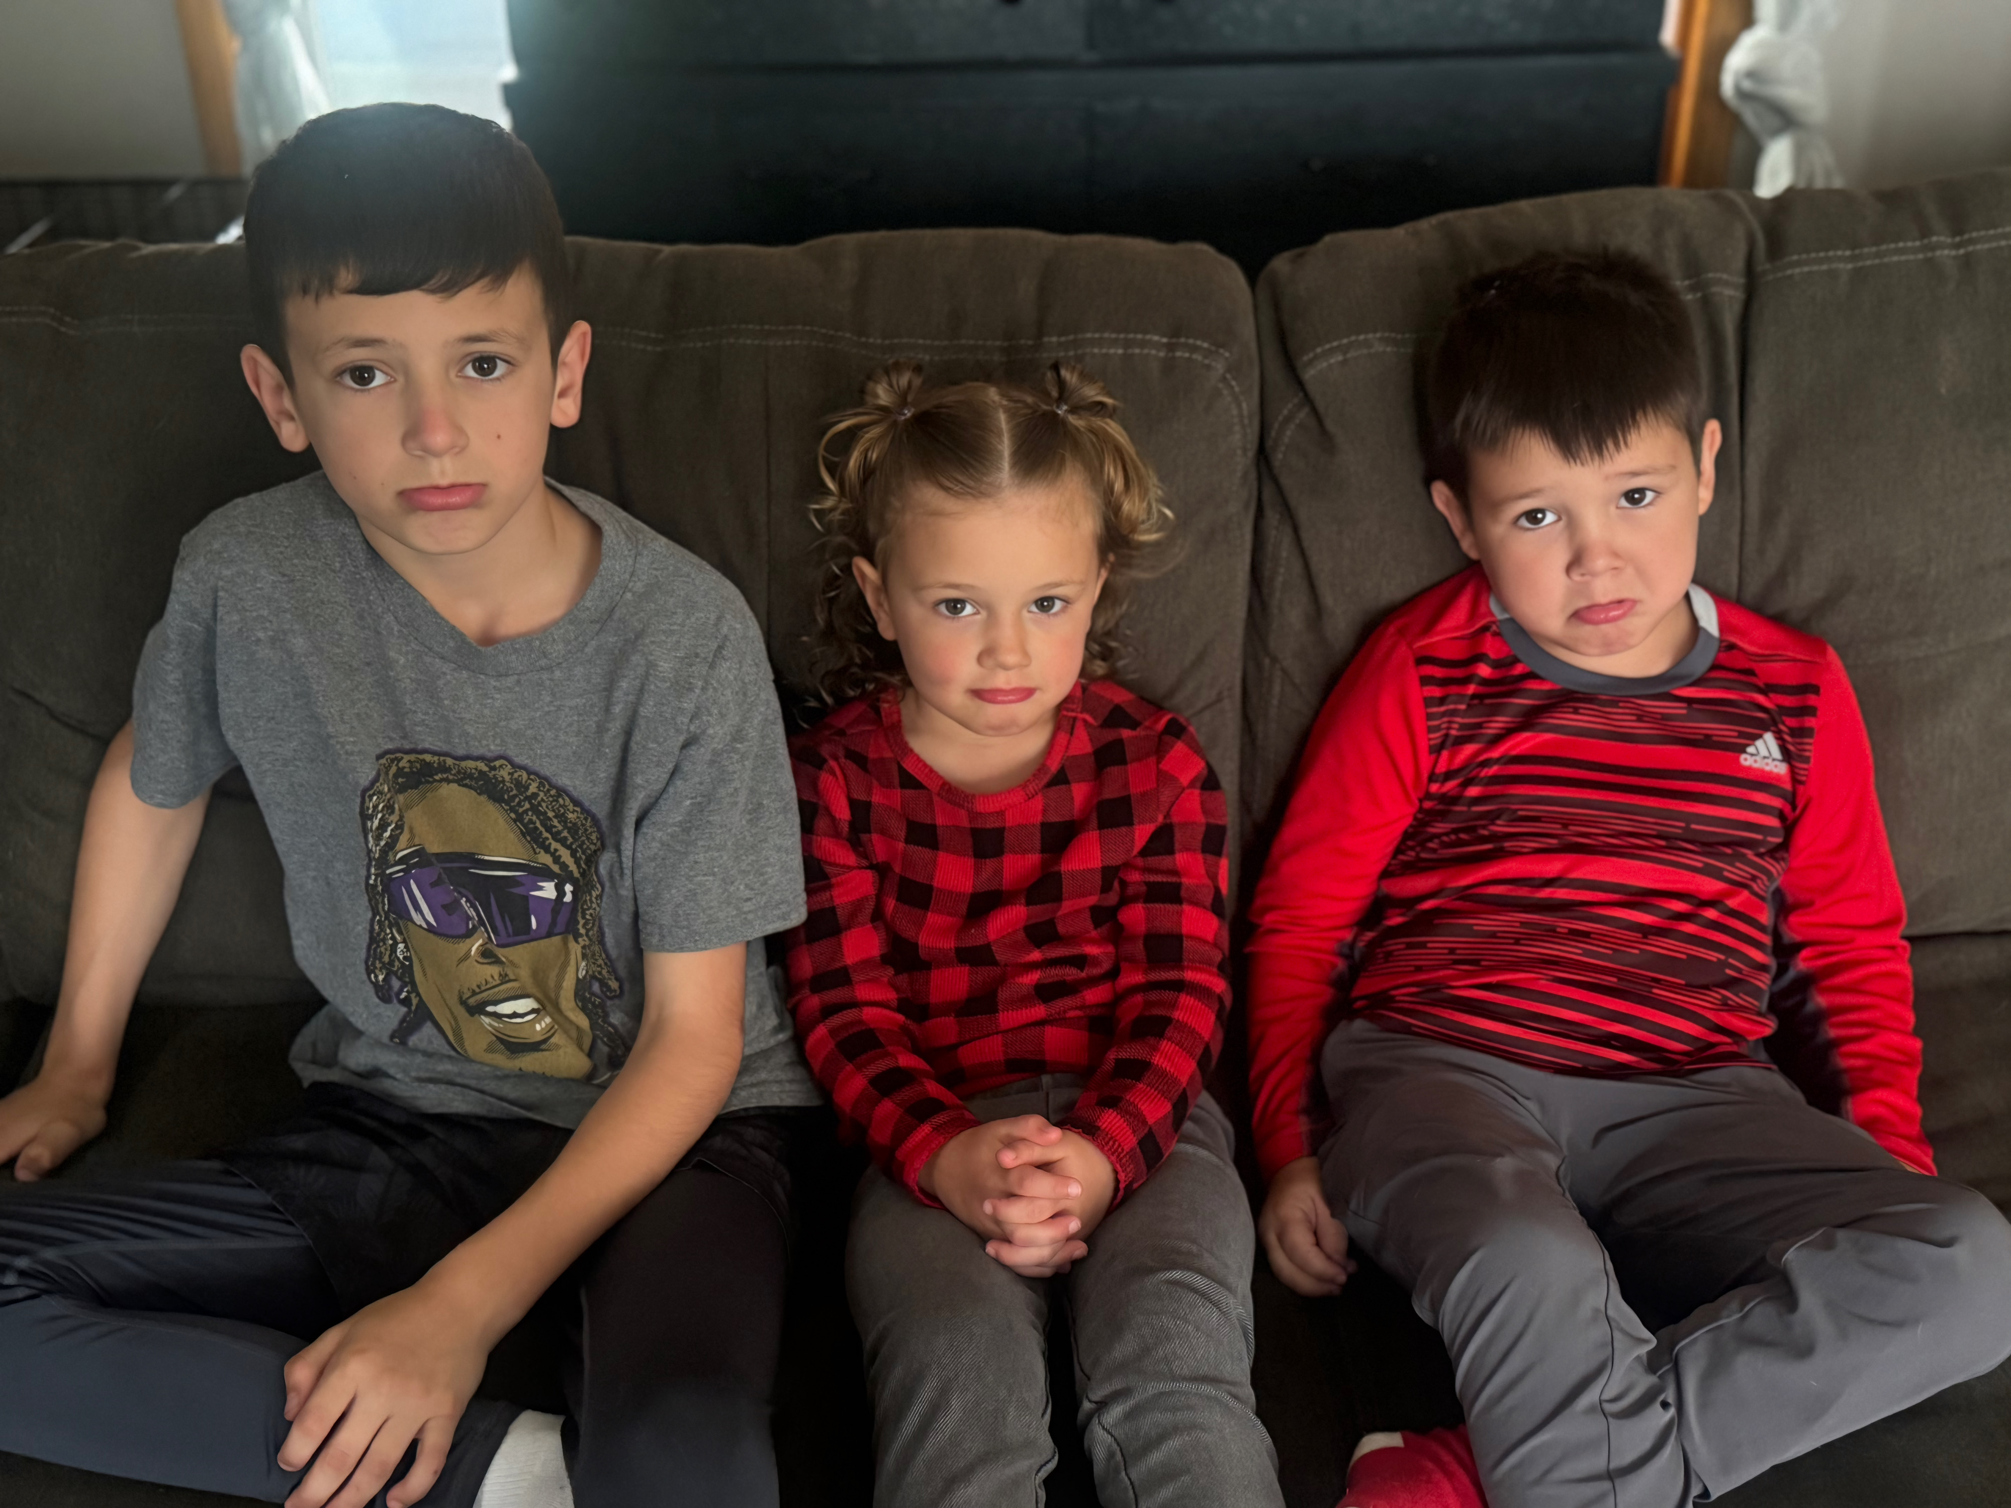
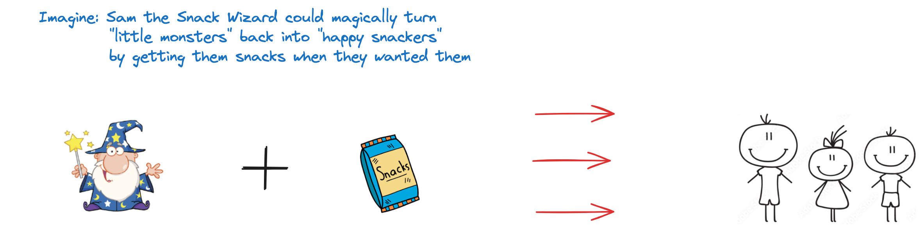
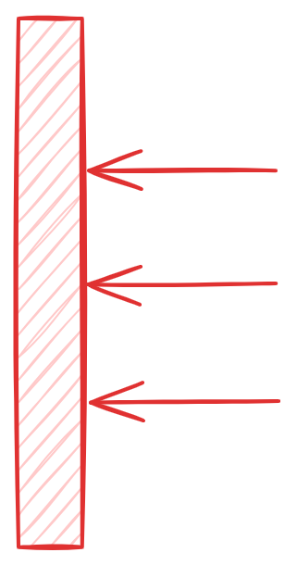
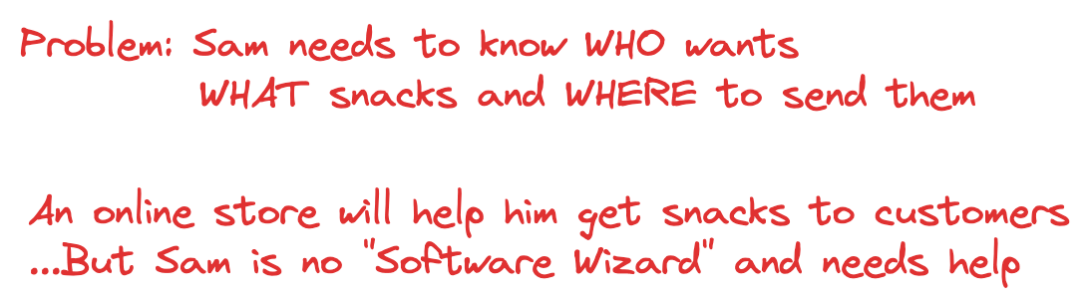
Set the Stage - ”The Persona”
X
Brady
Rylan
Oakley
Notes:
Persona - semi-fictional representation of a target user or customer, created to help the development team understand and empathize with their needs, goals, and behaviors.

Slide 8
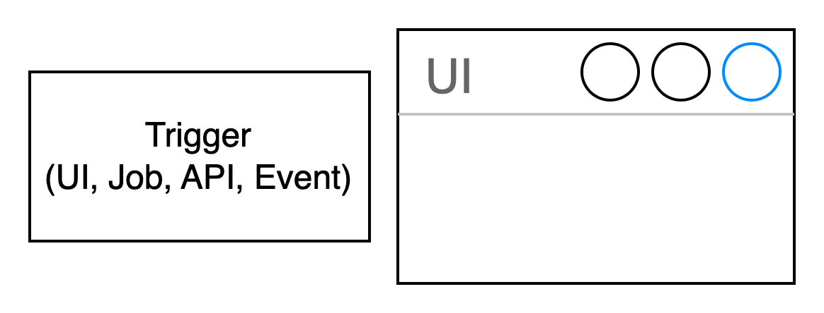
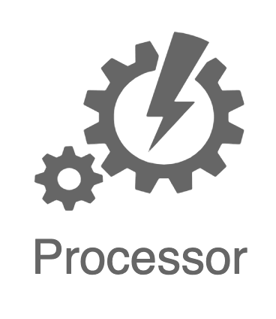
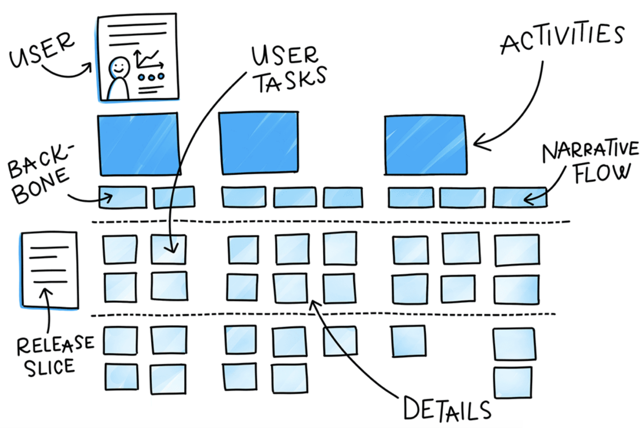
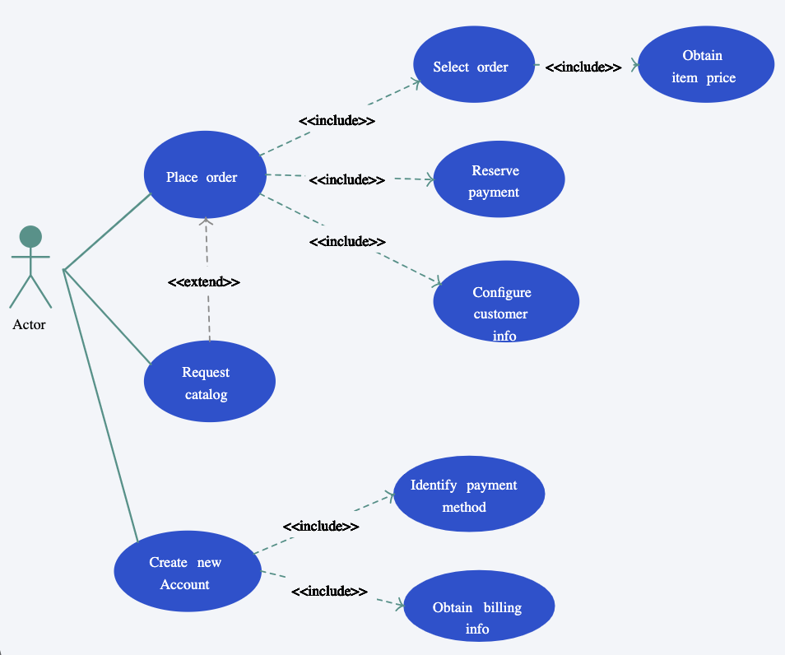
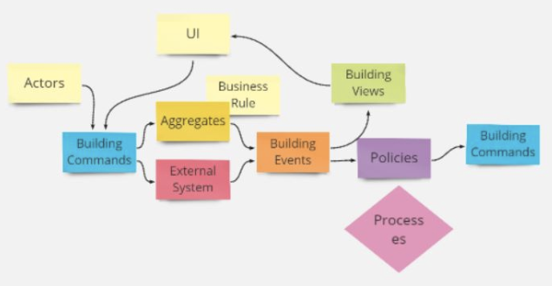
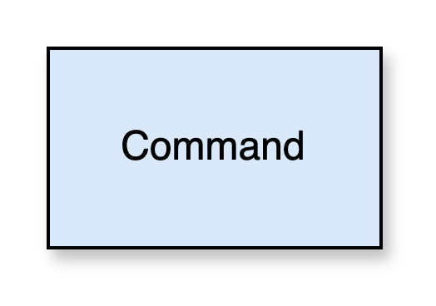
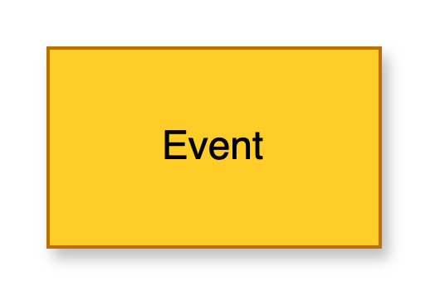
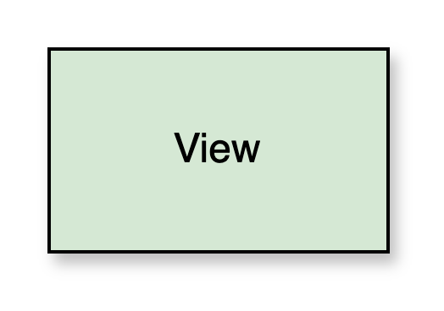
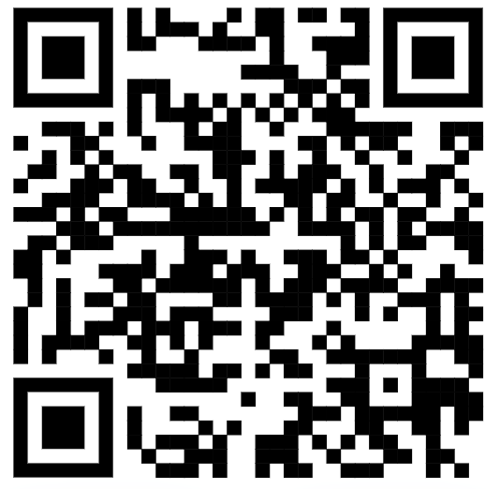
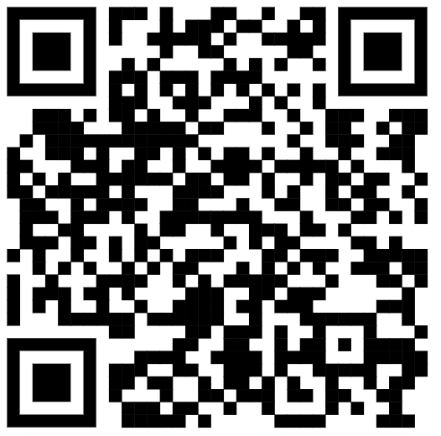
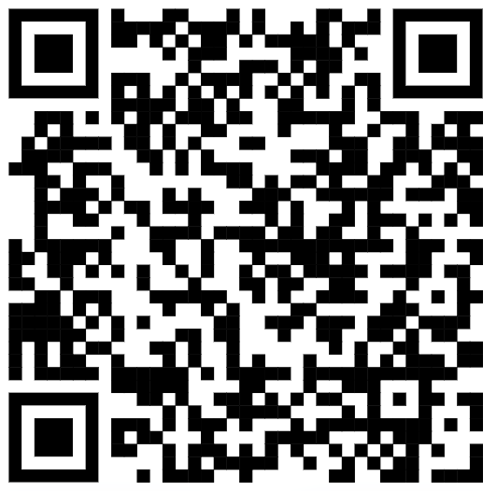
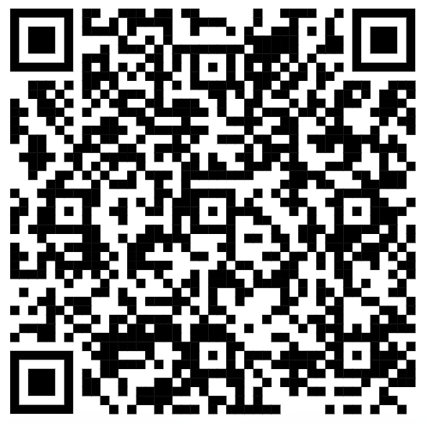
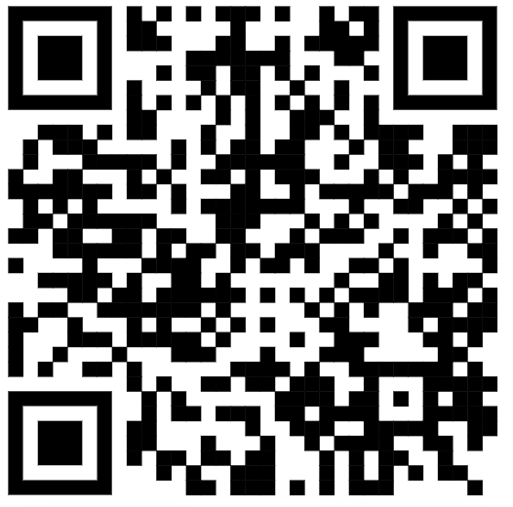
“Telling the Story” - Visualization
Pictographic Language
- Actors
- Work objects
- Activities
- Sequence
- Groups
- Annotations
Domain
Storytelling
Event Modeling
“Blueprinting”
User Story
Mapping
Use Case
Modeling
Event Storming
“next level”
event modeling

Slide 9
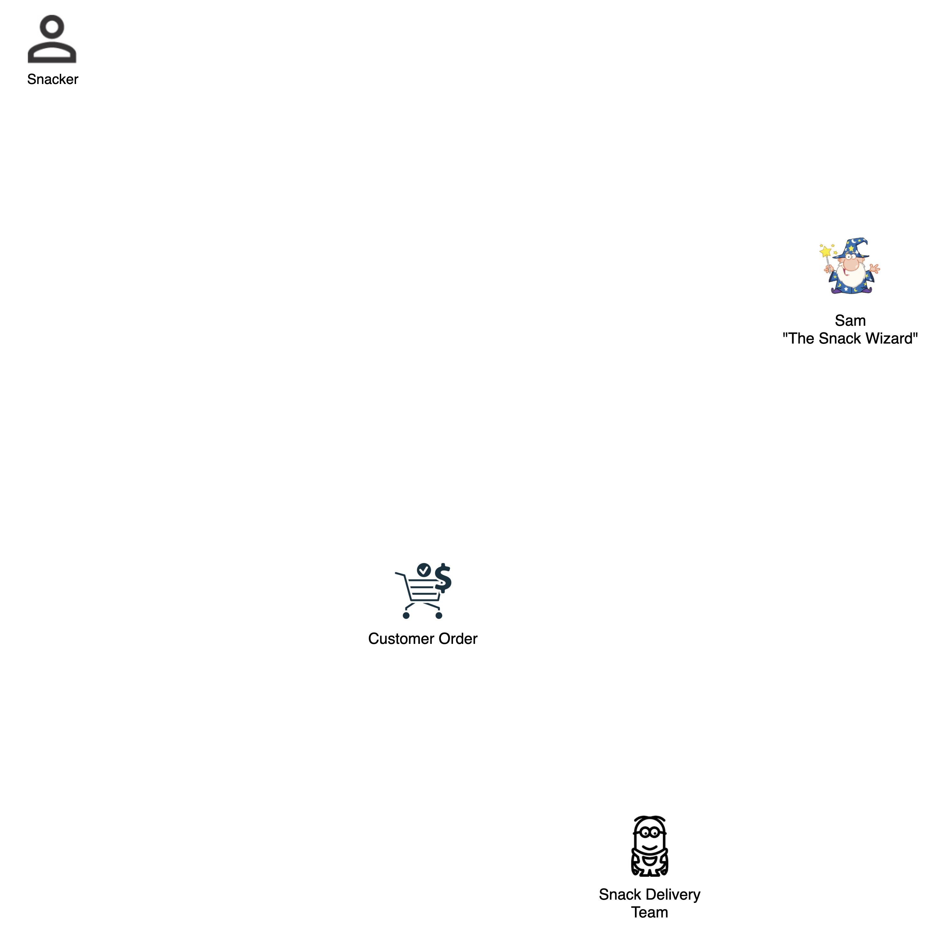

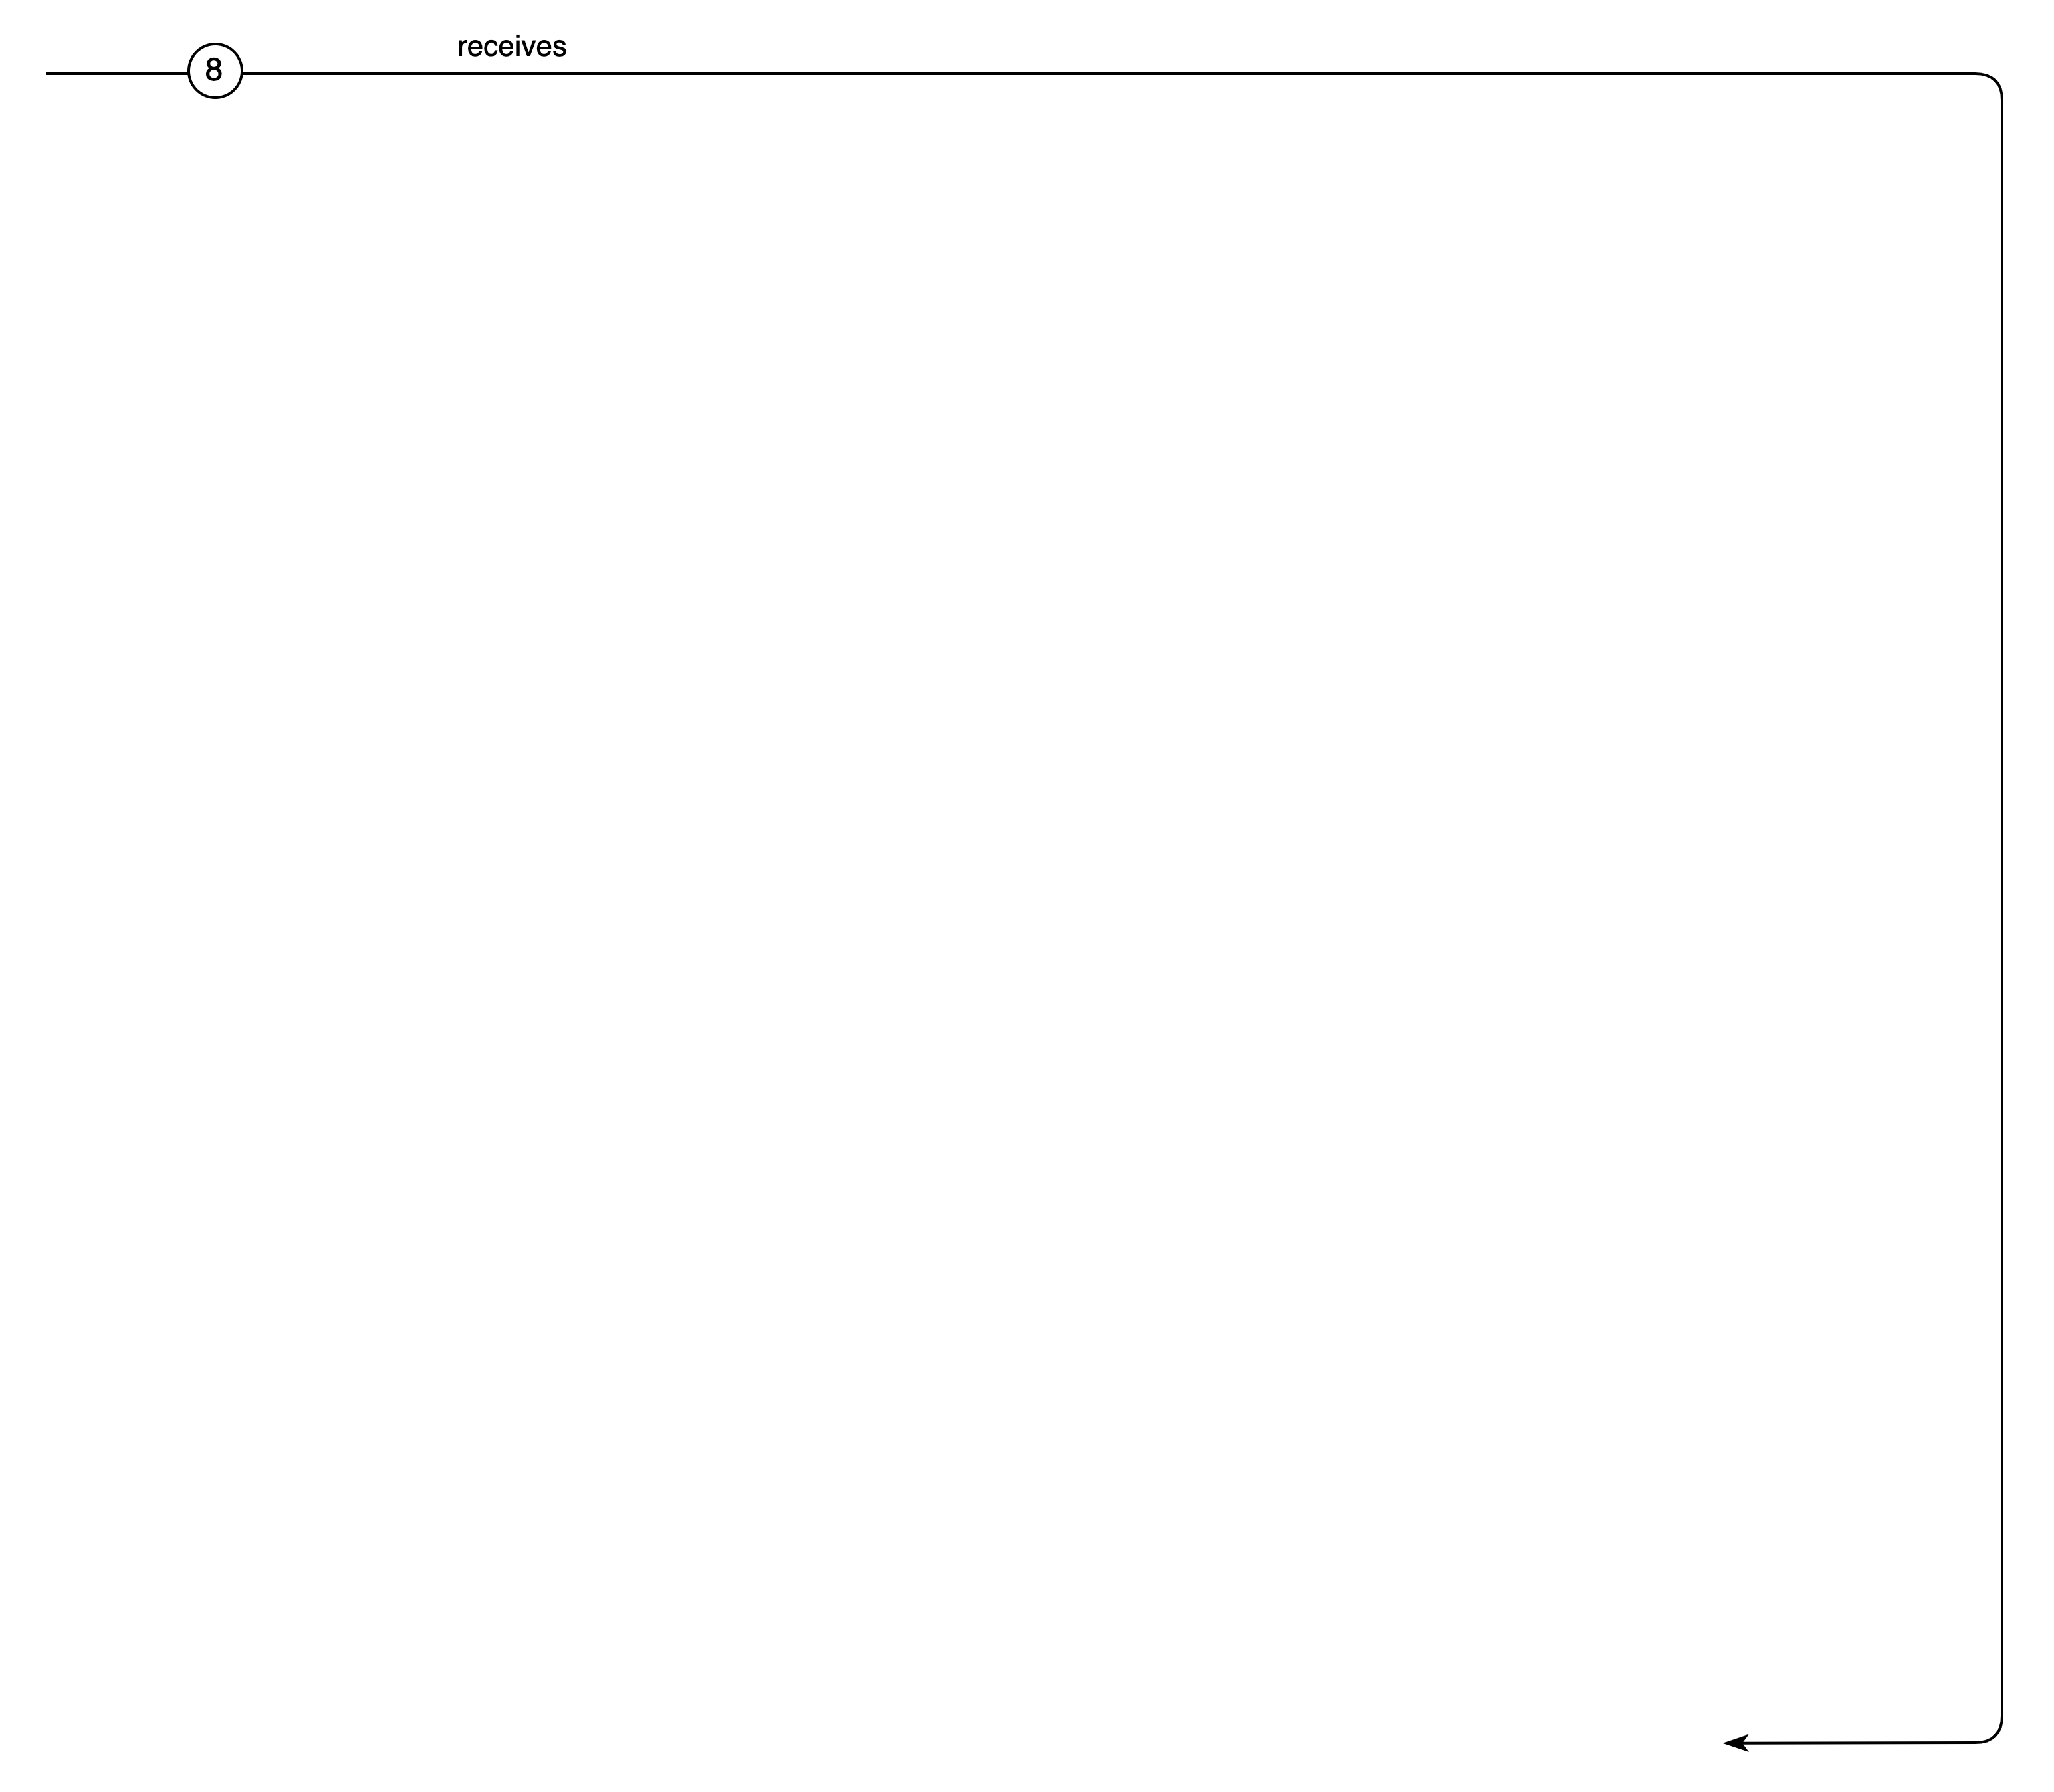
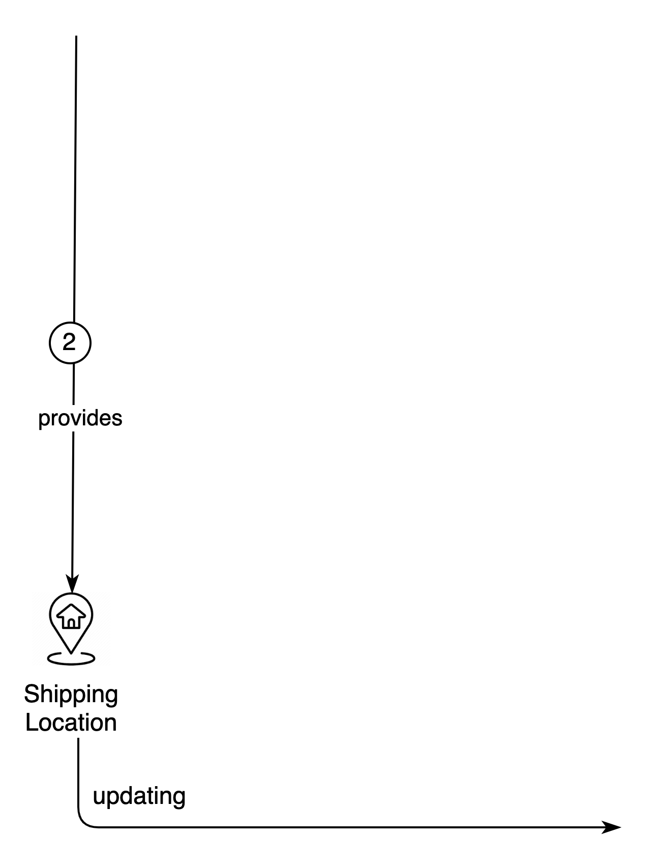
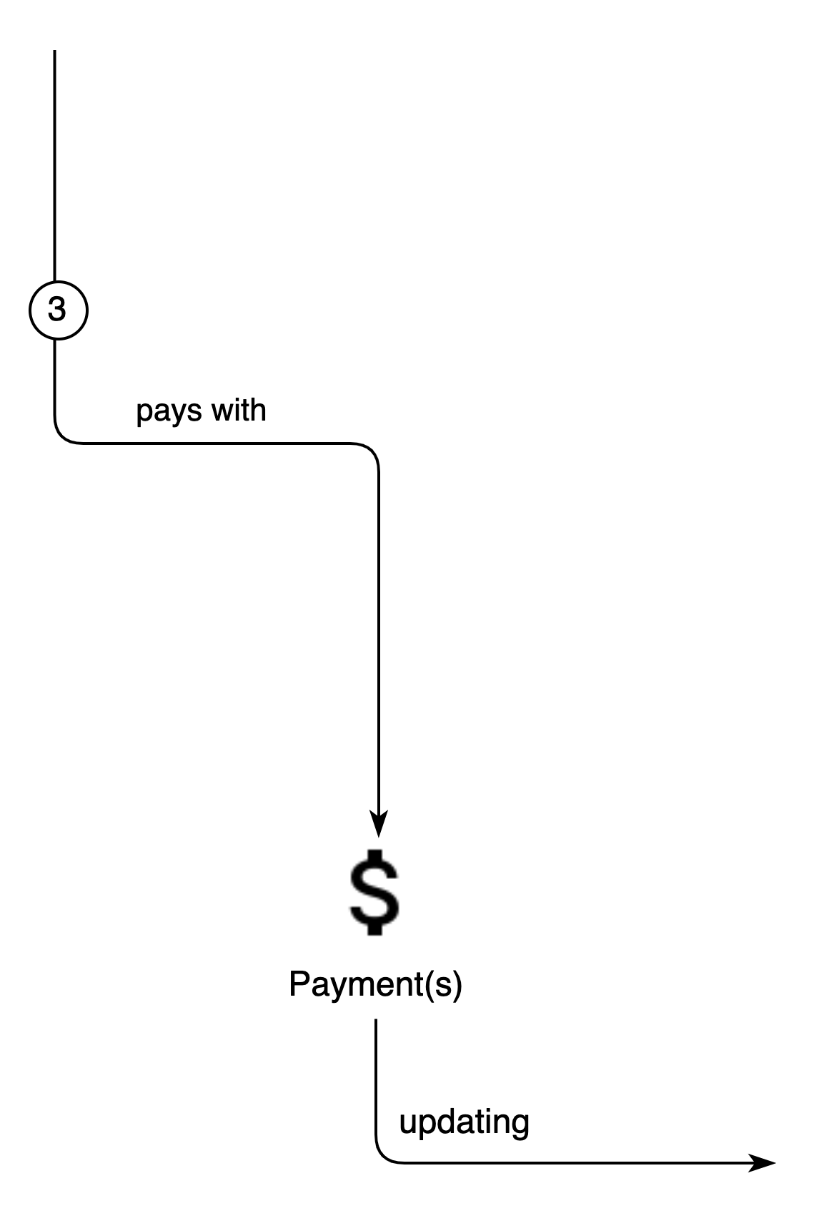
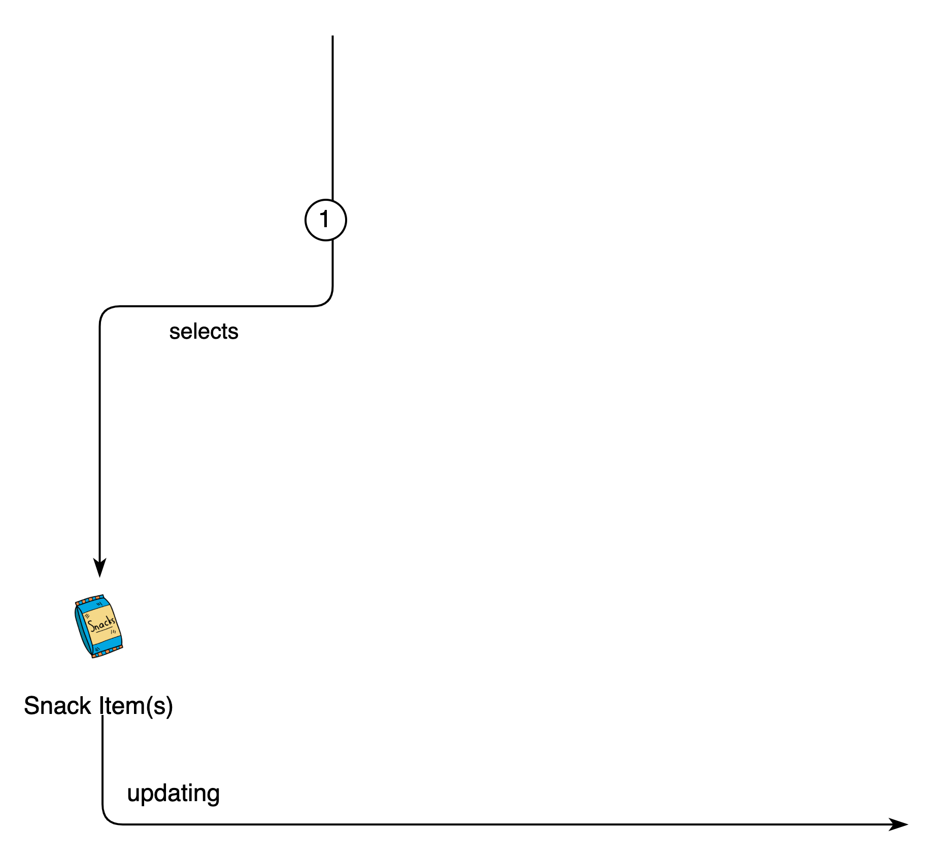
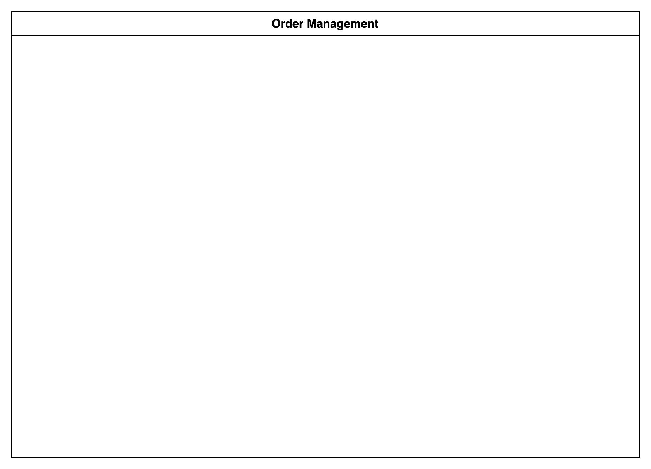
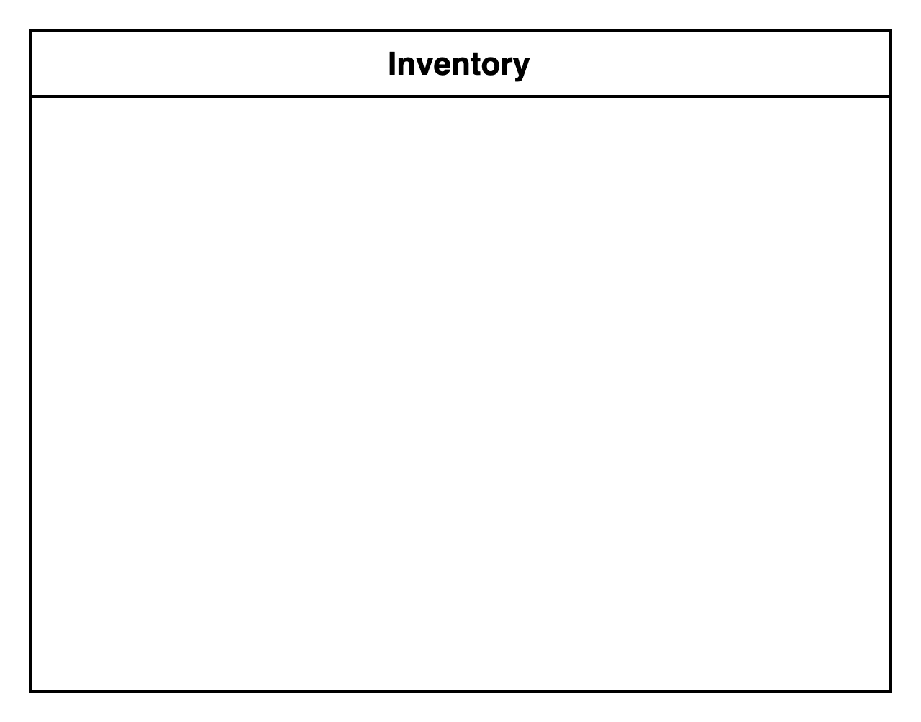
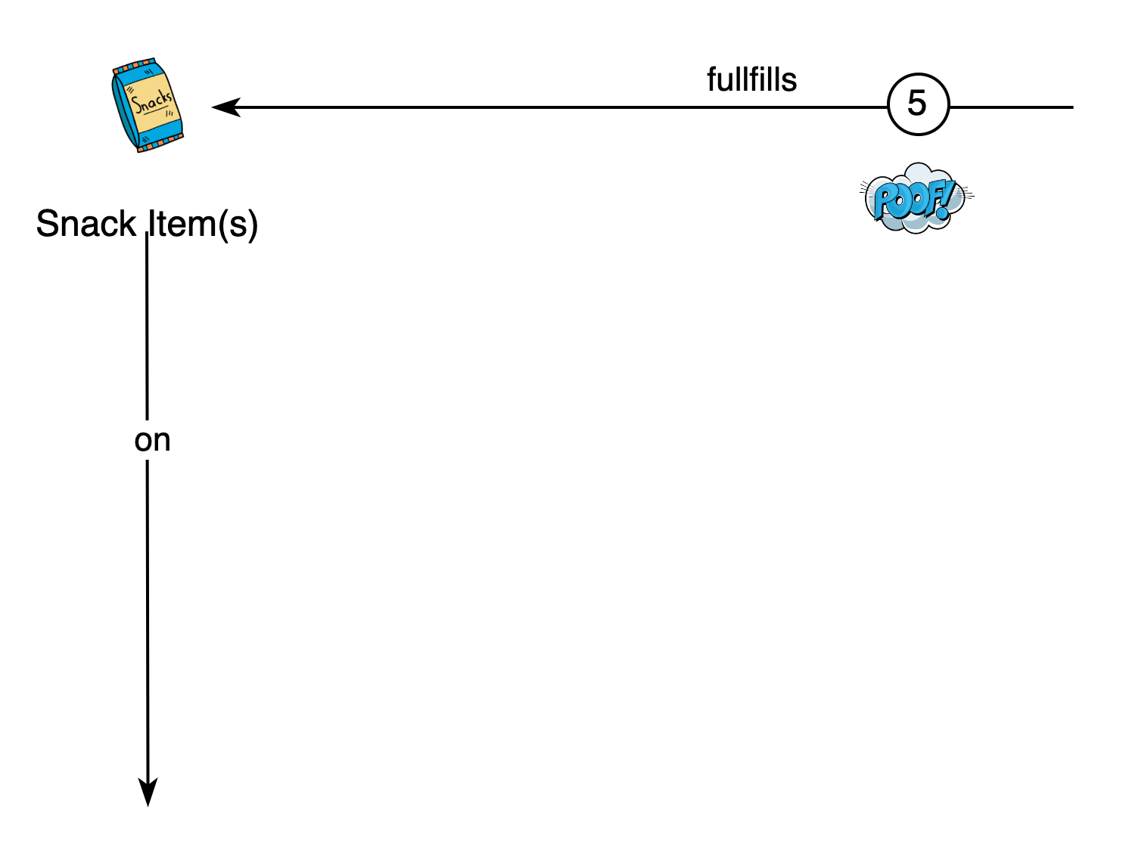
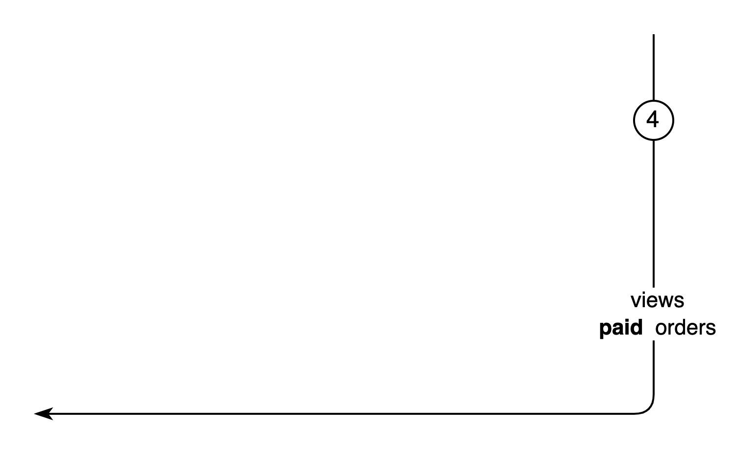
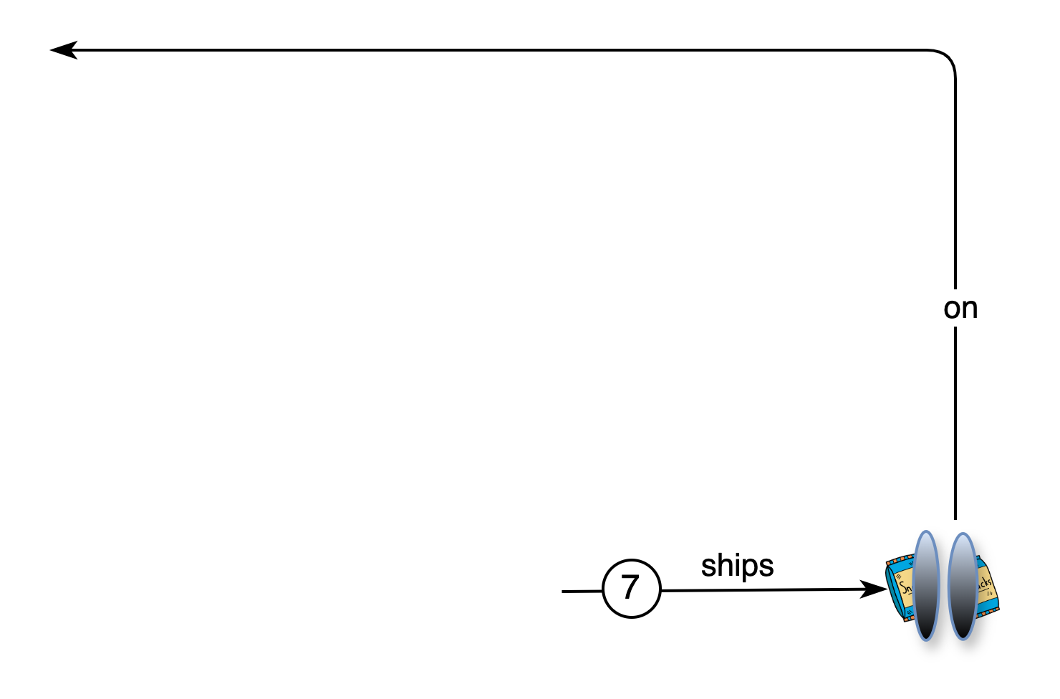
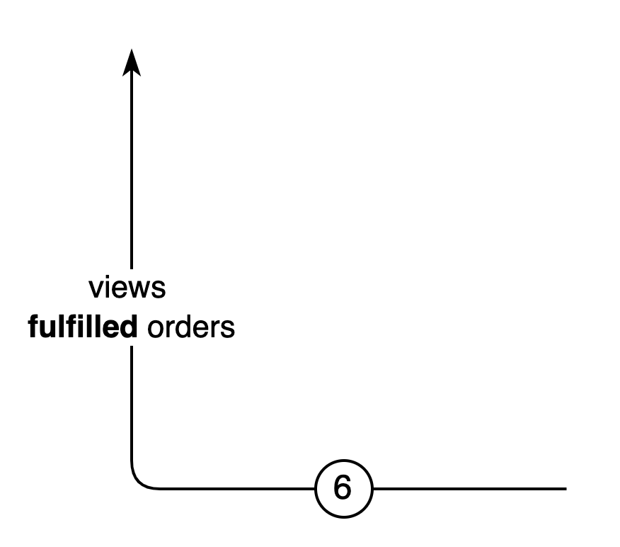
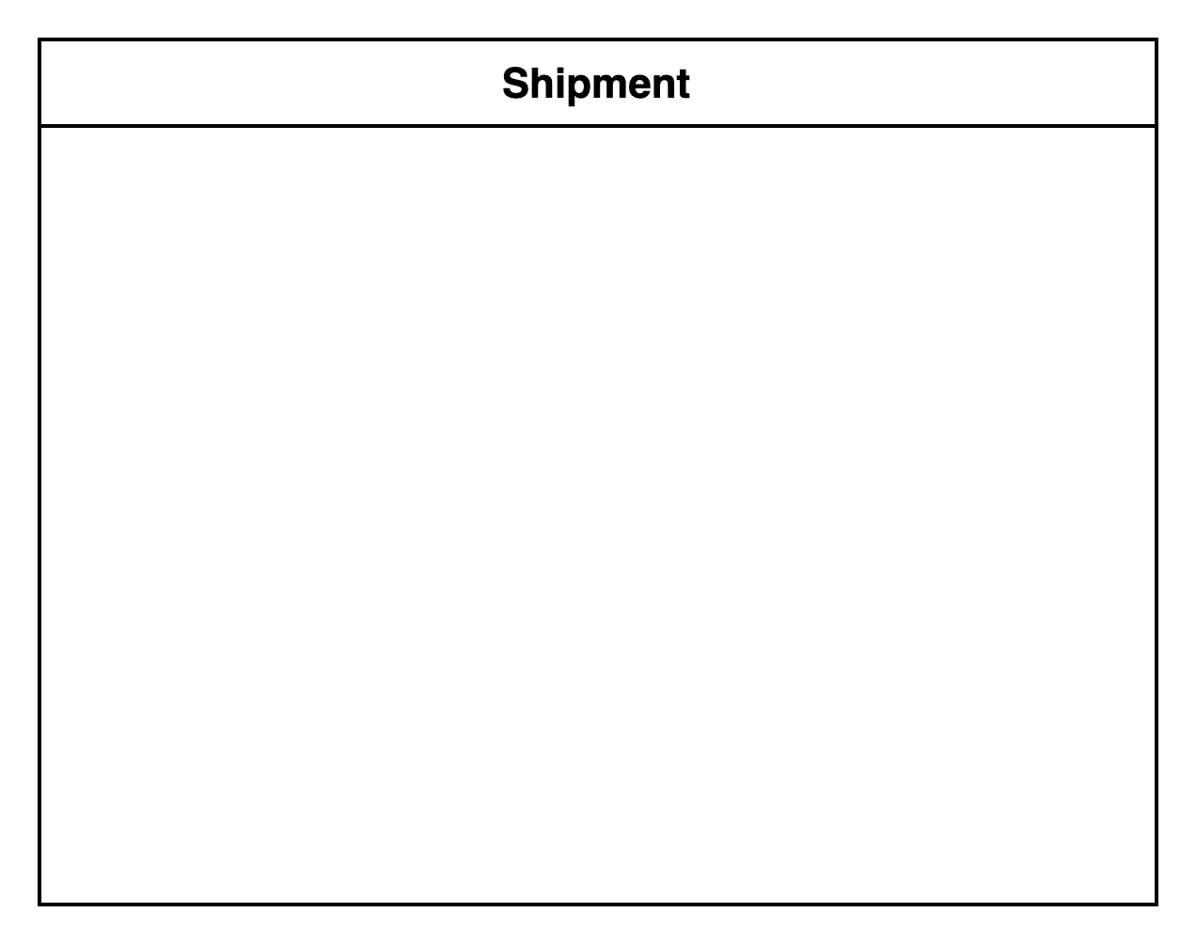
“Tell the Story” - Domain Storytelling
Pictographic Language
- Actors
- Work objects
- Activities
- Sequence
- Groups
- Annotations
“Your wishes are Sam’s commands”
“Sam needs a penny for your snacks”

Slide 10
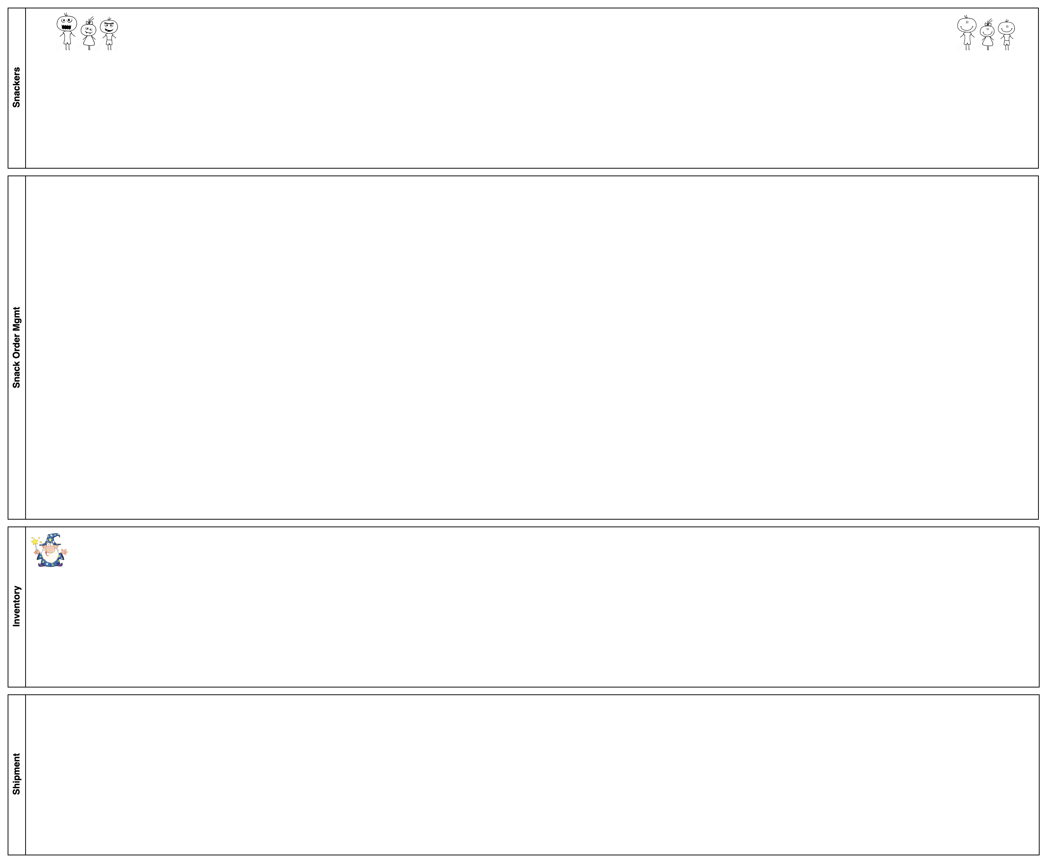
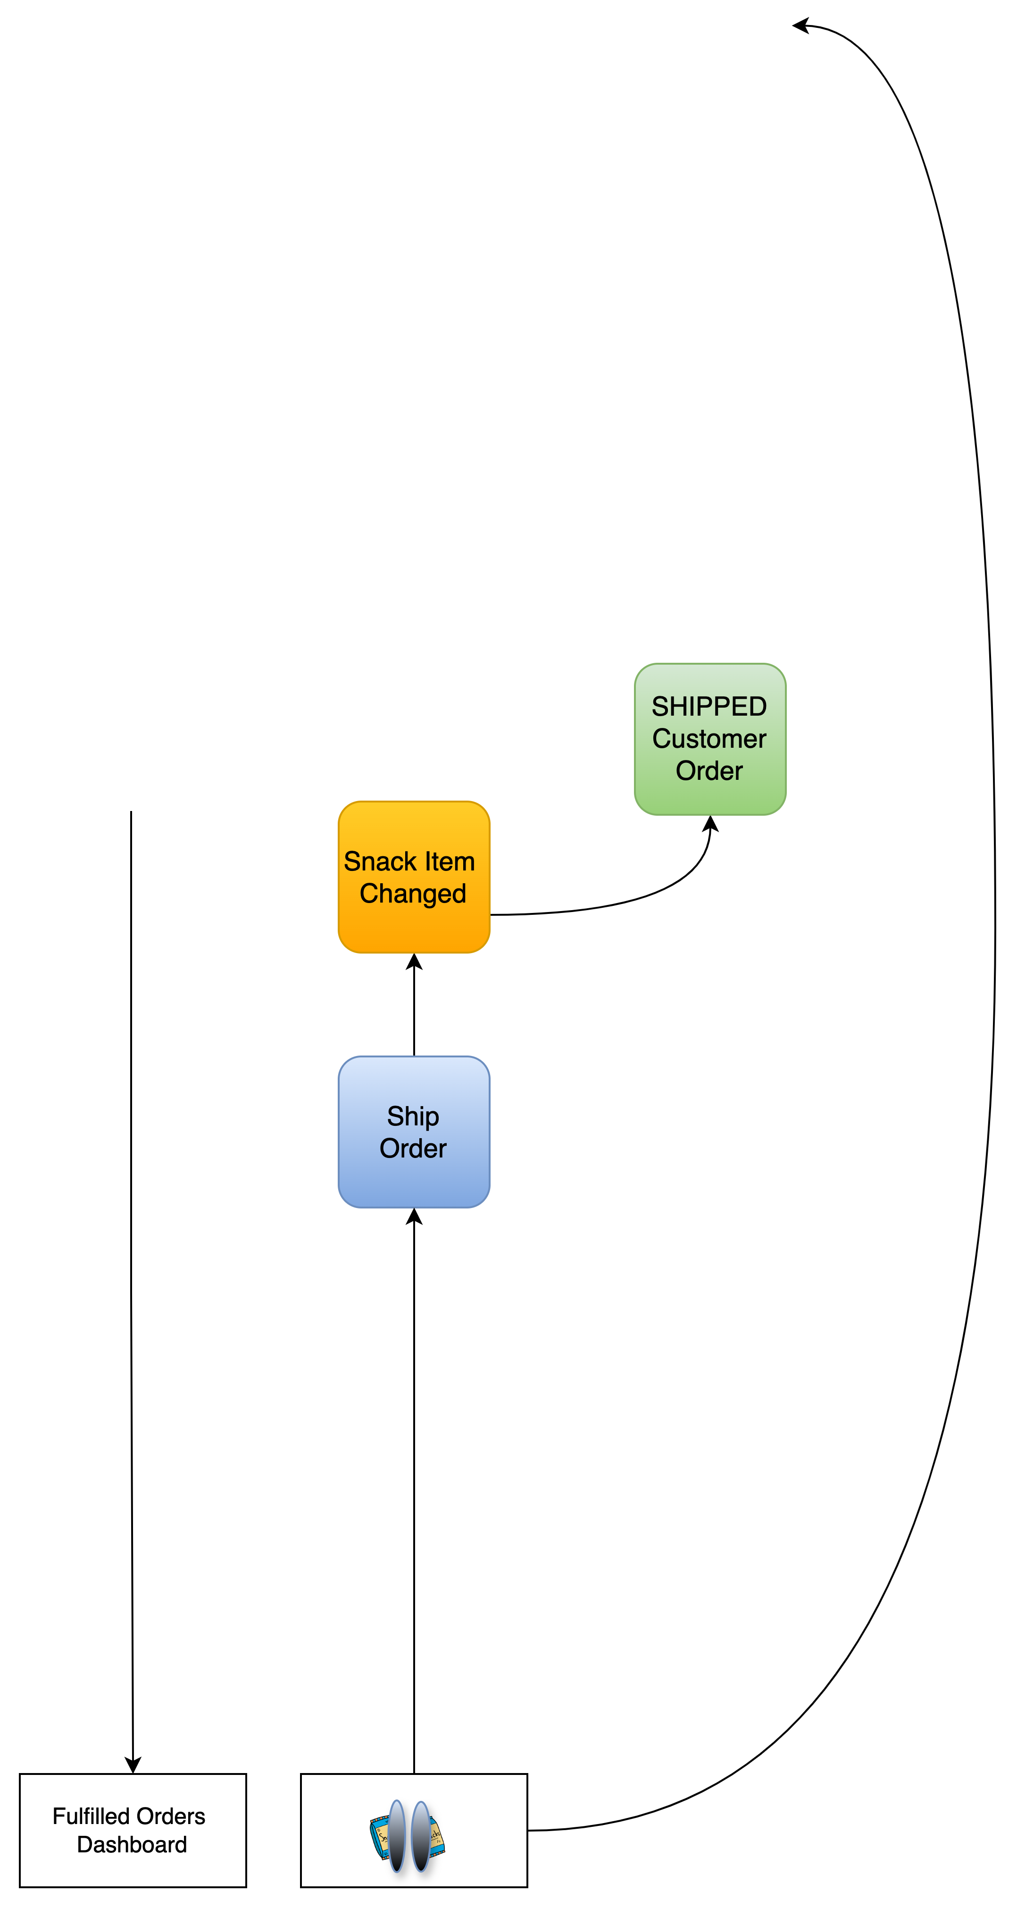
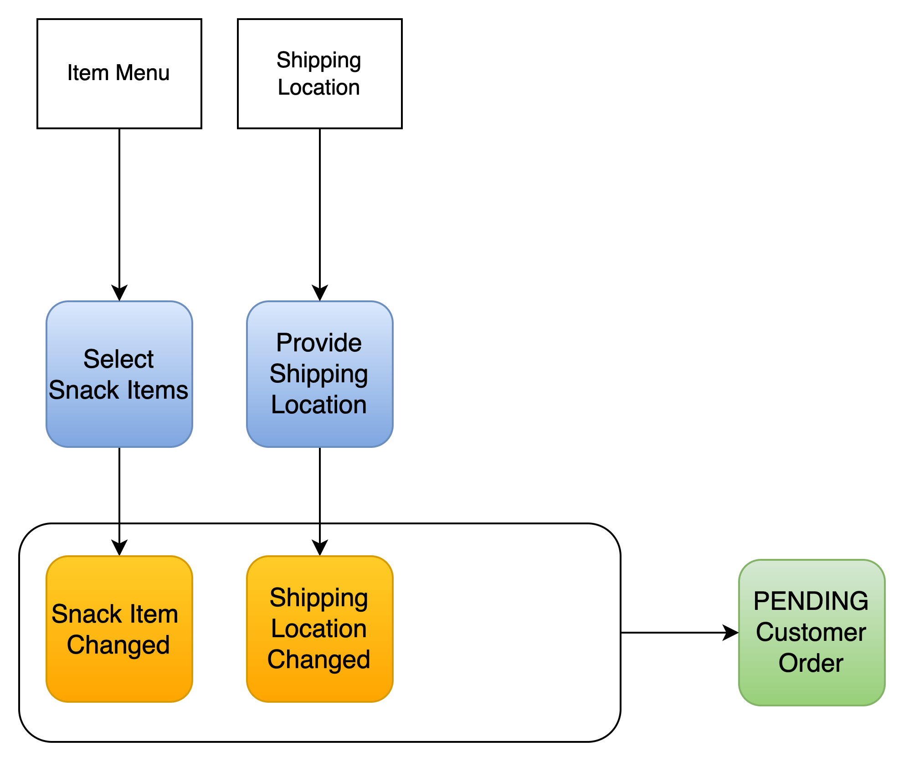
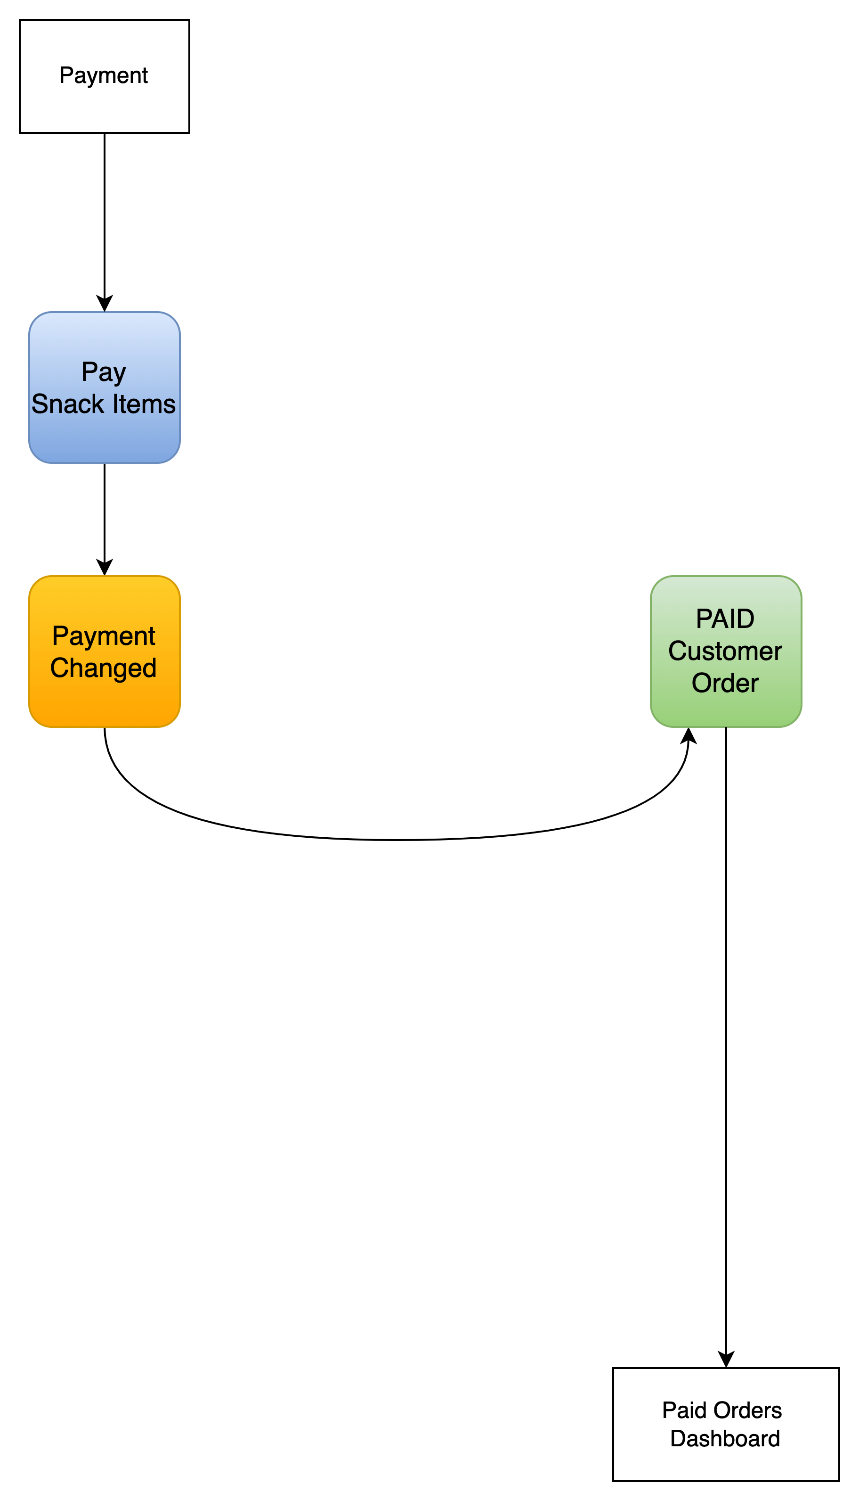

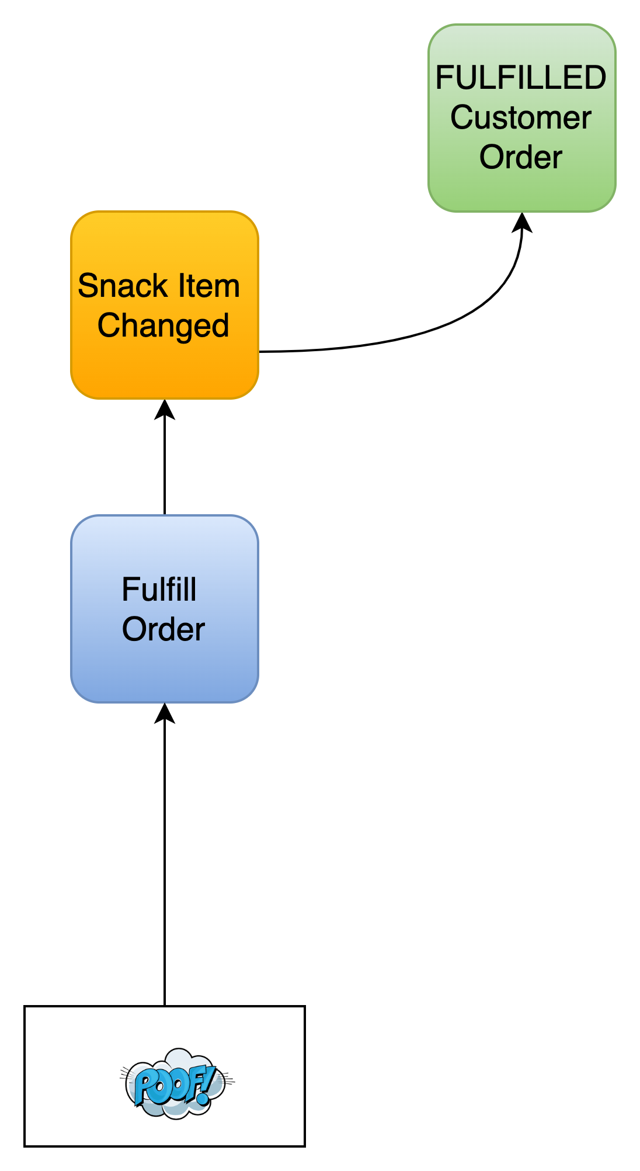

“Tell the Story” - Event Model Blueprinting
“Your wishes are Sam’s commands”
“Sam needs a penny for your snacks”

Slide 11


Slide 12
Design the Solution
Methods “That Guide” – DDD, System Design, C4 Modeling, 4+1 View

Slide 13


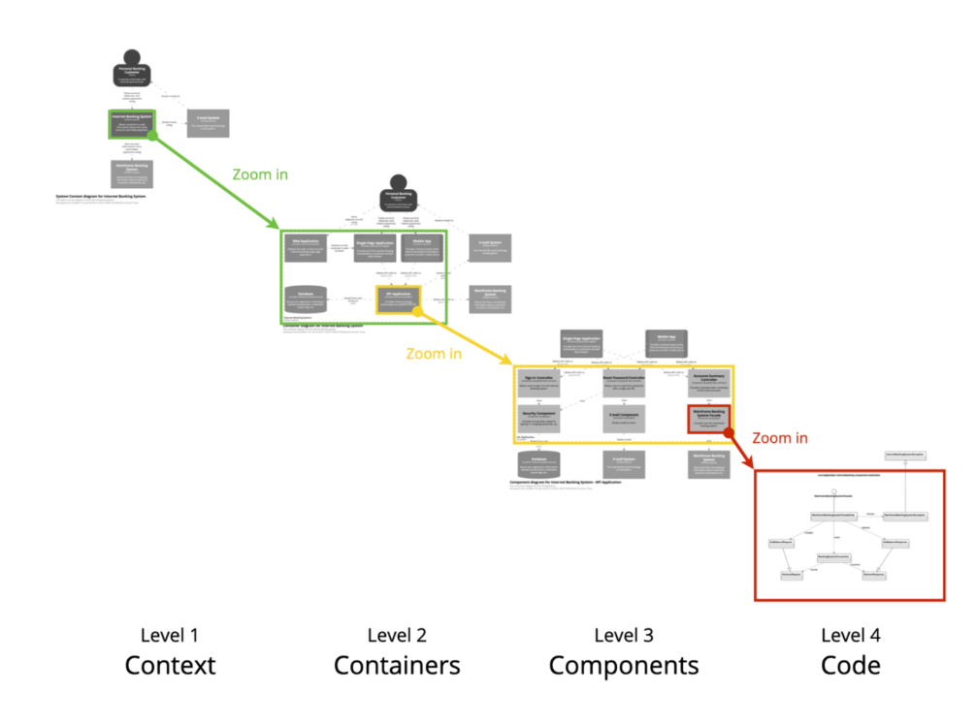
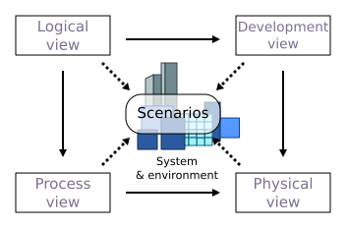
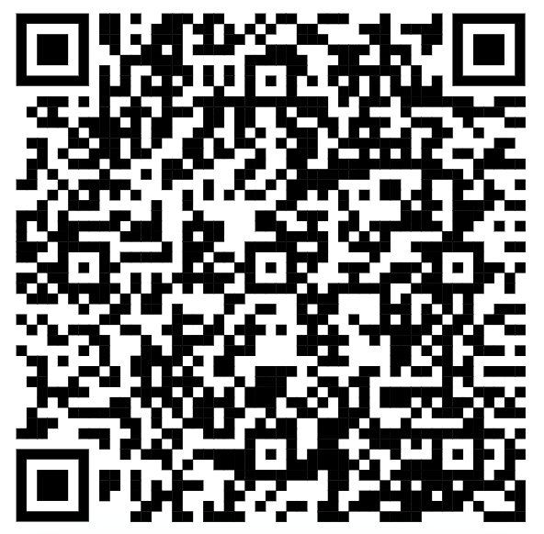
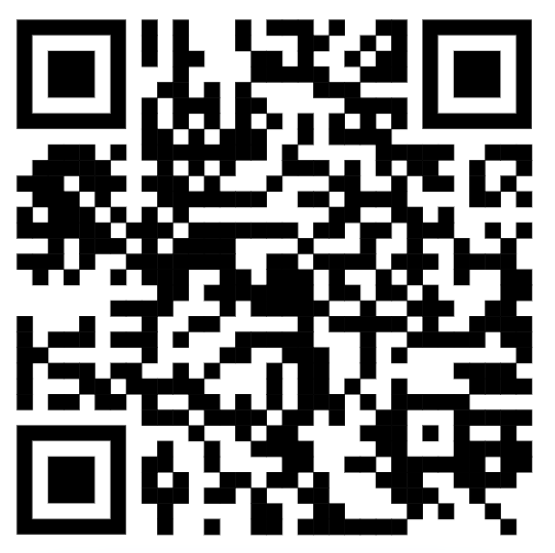


“Solution Methods”
Learning
Domain Driven Design
“The Method”
Righting Software
C4
Modeling
4+1
Architectural View

Slide 14










DDD Context Map

Slide 15









Righting Software “The Method” - System Design

Slide 16


DDD - Tactical Design Decisions
Snacks Unlimited - Order Management
Sub-domain: Supporting
Decision: Use domain model pattern and CQRS architectural pattern.
Why:
Quickly scale taking order commands from hungry snackers
Different persistent models to optimize handling snack order commands AND fulfilling snack customer orders
Solution:
Components: snack-order-commands (commands/writes) snack-customer-orders (query/read) snack-order-processor (DDD Aggregates)
Tech Stack: Kafka, Debezium CDC, and Kafka Streams OR Flink SQL to decouple CQRS services MySQL, MongoDB, Spring Boot, Gradle

Slide 17

4 + 1 Architectural View Model
Sprinkle in UML to complete the picture
Logical (state, class)
Process (sequence, activity, flow)
Development (package, modularity)
Physical (deployment, infrastructure)
Logical – State Diagram
Customer Order

Slide 18







C4 Model (Context)

Slide 19

C4 Model (Container)

Slide 20

Streams Topology (Component)

Slide 21

FlinkSQL Job Overview (Component)
CDC to Kafka
DDD Aggregate to Kafka
<kafka topic>
Item_details
<kafka topic>
customer-order-aggregate
<kafka topic>
Shipping_location
<kafka topic>
payment

Slide 22


Slide 23
Demo the Result
“The Playground”

Slide 24



Playground – Kafka vs Redpanda vs WarpStream

Slide 25

DEMO: API-Driven
Notes:
Redpanda is a streaming platform that is compatible with the Kafka protocol / APIs while eliminating the internal complexities of Kafka

Slide 26

Promotion – Limited Time Offer
Scan & WIN!!
HURRY!!

Slide 27



Slide 28


Check it out on GitHub
(https://github.com/improving-minnesota/demo-ordermgmt-cqrs-cdc)

Slide 29
Appendix
Extra Slides

Slide 30

☺ Twin Cities Solution Architecture Meetup ☺

Slide 31










+
+
+
=
+
+
+
=

Slide 32
References
Source Material
Improving GitHub - demo-ordermgmt-cqrs-cdc
Original Tutorial – Building DDD Aggregates via CQRS/CDC
Telling the Story - Methods
Domain Storytelling
Event Modeling - Blueprinting
Event Storming
User Story Mapping
Use Case Modeling
Solutioning
Learning Domain-Driven Design
Righting Software
C4 - Modeling (Arch)
4+1 Architecture View Model
Development
Kafka Streams in Action, Second Edition
Mastering Kafka Streams and ksqlDB
Spring Modulith

